Slide 1
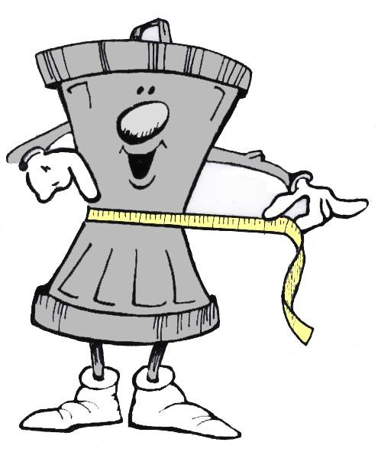
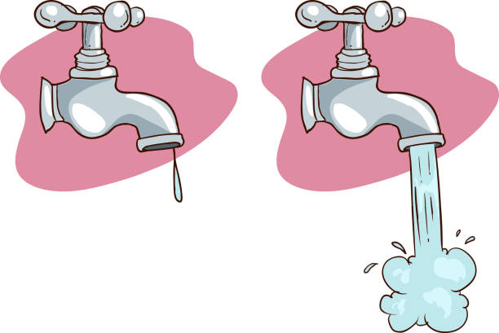
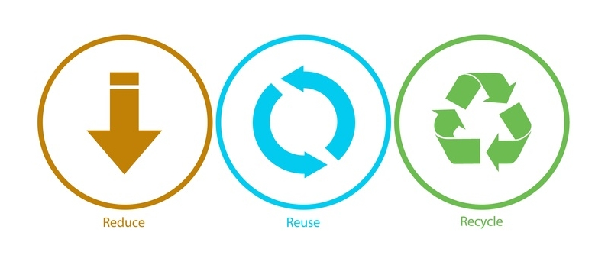
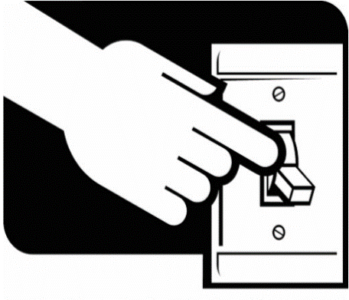
SOLUTIONS
Don’t smoke
Reduce waste
Turn off the tap
Reuse, Reduce, Recycle
Turn off the lights

Slide 2
Plant trees
Go on foot
Stop buying clothing
Eat organic food
Recycle bottles and bags

Slide 3
Observa las expresiones de la izquierda y relaciona con las imágenes de la derecha.
. Turn off the lights
- Reduce, Reuse, Recycle
- Go on foot
- Plant trees
- Turn off the tap
- Don’t Smoke
- Eat Organic Food
- Recycle bottles and bags
- Stop buying clothes
- Reduce Waste

Slide 4
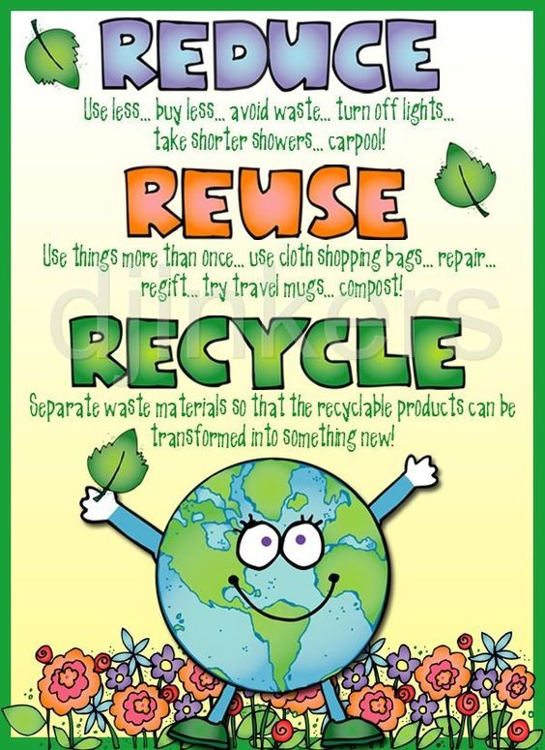

Slide 5
THE FANTASTIC THREE Rs
REUSE | REDUCE | RECYCLE
Clothes | Turn off the light | Water bottles
Books | Ride a bike | Glass bottles
Bags | Turn off the tap | Soda cans
Boxes | Stop buying | Newspapers
Use
paper

Slide 6
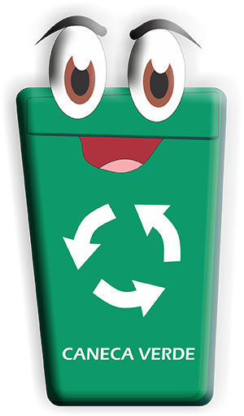
RECYCLE
REUSE
REDUCE
Observe y Piense: ¿ En cuál caneca colocaría cada una de las siguientes acciones ?
Use the paper on both sides - Stop buying packaged food
Take shorter showers - Refill bottles of water
-Give clothes o other people
- Use glass bottles as containers
- Carry a cloth bag for shopping
- Use plasic bottles as plant pots
- Organize rubbish into bins

