Slide 1

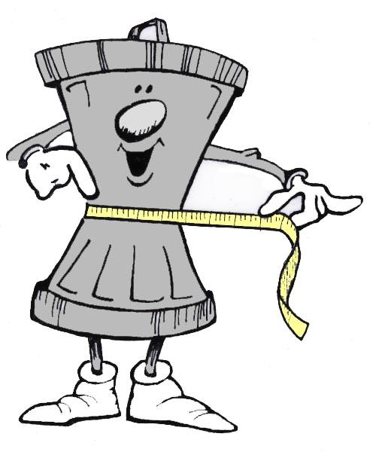
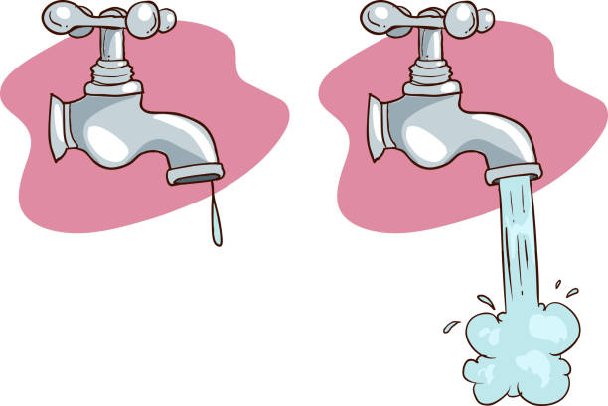
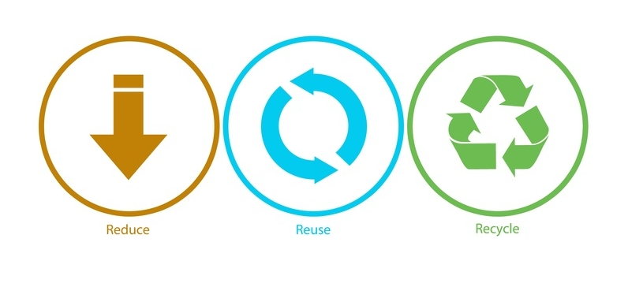
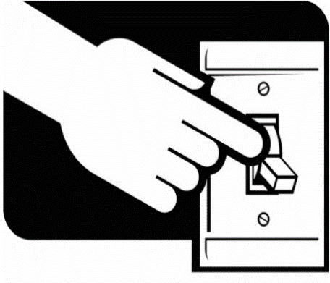

SOLUTIONS
Don’t smoke
Reduce waste
Turn off the tap
Reuse, Reduce, Recycle
Turn off the lights

Slide 2





Plant trees
Go on foot
Stop buying clothing
Eat organic food
Recycle bottles and bags

Slide 3
Observa las expresiones de la izquierda y relaciona con las imágenes de la derecha.
. Turn off the lights
- Reduce, Reuse, Recycle
- Go on foot
- Plant trees
- Turn off the tap
- Don’t Smoke
- Eat Organic Food
- Recycle bottles and bags
- Stop buying clothes
- Reduce Waste

