Slide 1
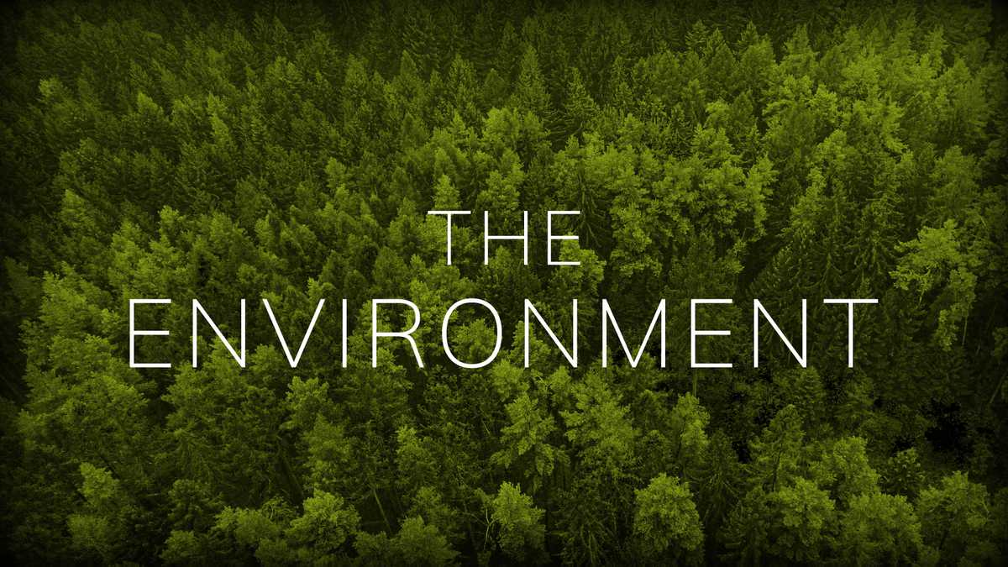

Slide 2
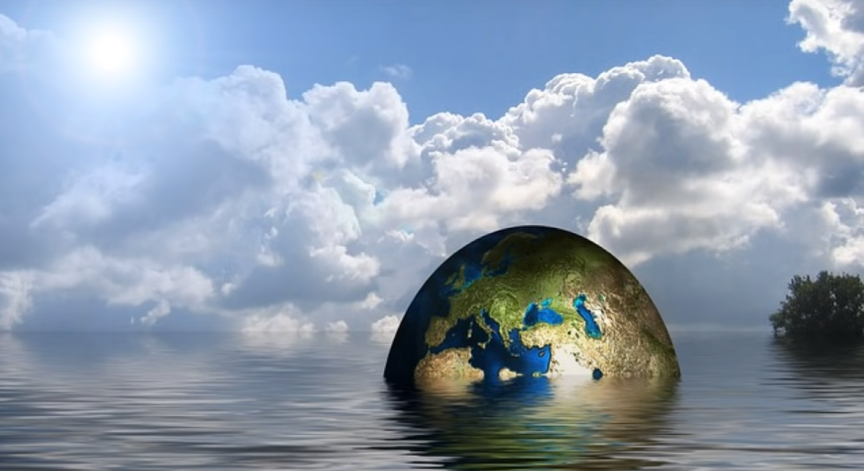
Learn environmental
vocabulary

Slide 3
Environment Resources Deforestation
Pollution Forest Save
Soil Footprint Fumes
Water Rubbish Earth
Air Rivers Cut down
Waste

