Slide 1
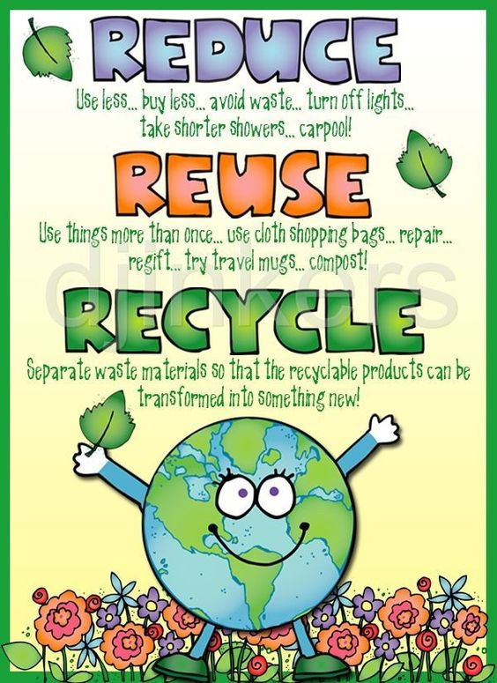


Slide 2
THE FANTASTIC THREE Rs
REUSE | REDUCE | RECYCLE
Clothes | Turn off the light | Water bottles
Books | Ride a bike | Glass bottles
Bags | Turn off the tap | Soda cans
Boxes | Stop buying | Newspapers
Use
paper

Slide 3
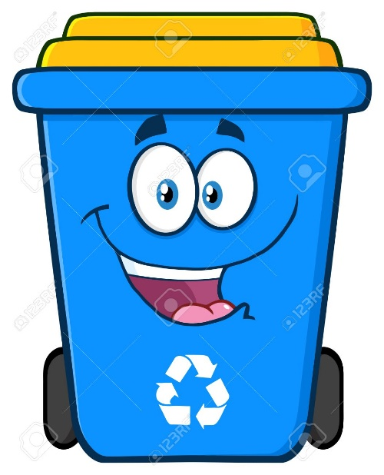
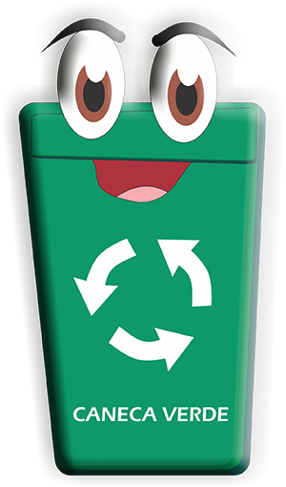
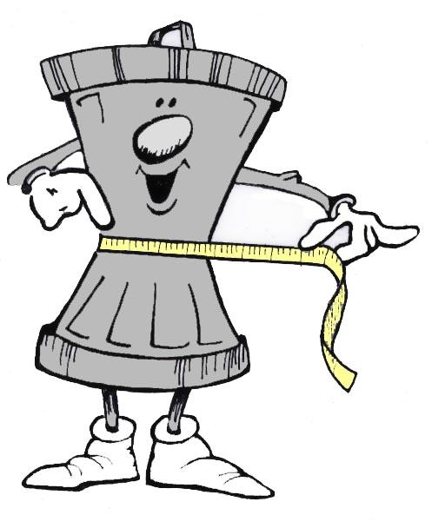
RECYCLE
REUSE
REDUCE
Observe y Piense: ¿ En cuál caneca colocaría cada una de las siguientes acciones ?
Use the paper on both sides - Stop buying packaged food
Take shorter showers - Refill bottles of water
-Give clothes o other people
- Use glass bottles as containers
- Carry a cloth bag for shopping
- Use plasic bottles as plant pots
- Organize rubbish into bins

