Slide 1

MY ECOFOOTPRINT
It is a measure of how much of the environment we use to support our lifestyle. These are things we take from the environment to live.
NATURAL RESOURCES
AIR
WATER
SOIL
FOOD
ENERGY
PLANTS - TREES
THINGS
CLOTHES
TRANSPORTATION: Cars, Moto, bike, bus.
APPLIANCES: Fridge, T.V.s, Microwave, Sound system, Video game consoles, computers.
BOOKS

Slide 2


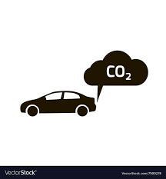


ENVIRONMENTAL PROBLEMS
Rubbish
Fumes of cars
Pesticides
Global warming
Energy consumption

Slide 3
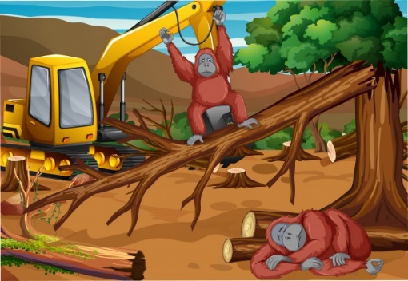



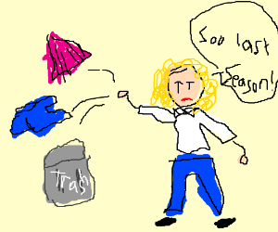
ENVIRONMENTAL PROBLEMS
Deforestation
Water waste
Smoking
Throw away
Use of plastic

Slide 4

Pesticides
Rubbish
Water waste
Smoke
Throw Away
Deforestation
Fumes of cars
Use of plastic
Energy consumption
Global Warming

