Slide 1

Fabiana Valentina Abreu Herrera
501
https://www.youtube.com/watch?v=7ahecOwTicU

Slide 2
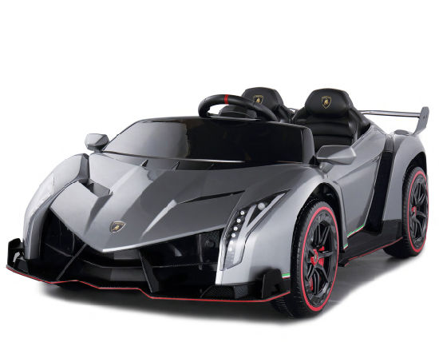
DO YOU HAVE
toy car

Slide 3
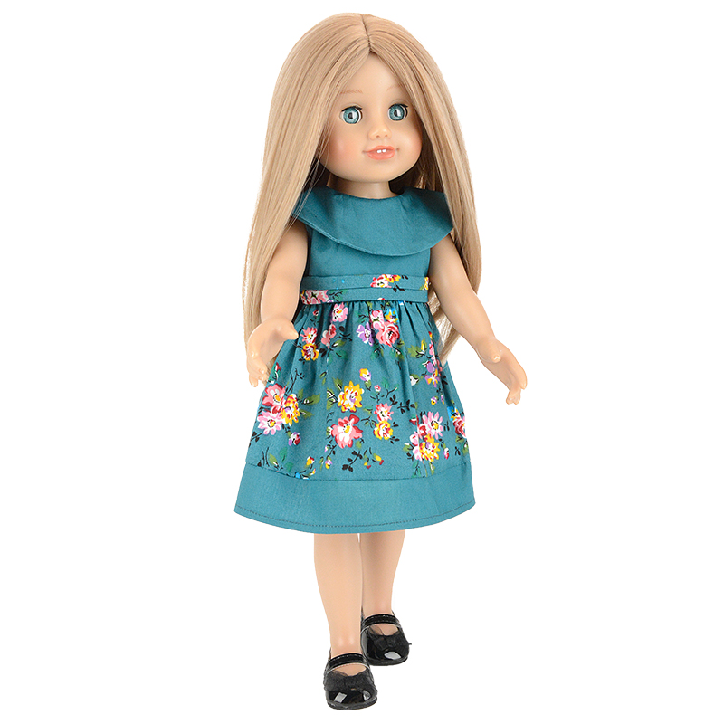
DO YOU HAVE
wrist

Slide 4
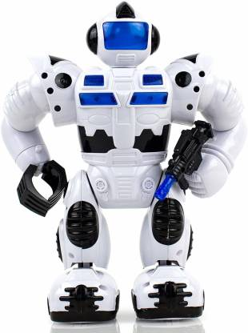
DO YOU HAVE
robot

