Slide 1
BIOSECURITY
vocabulary

Slide 2
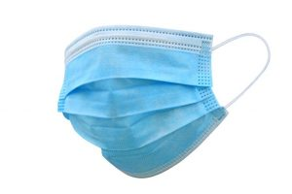

Pronunciation
Spelling
FACE MASK

Slide 3
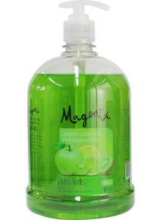
Pronunciation
Spelling
SOAP

Slide 4
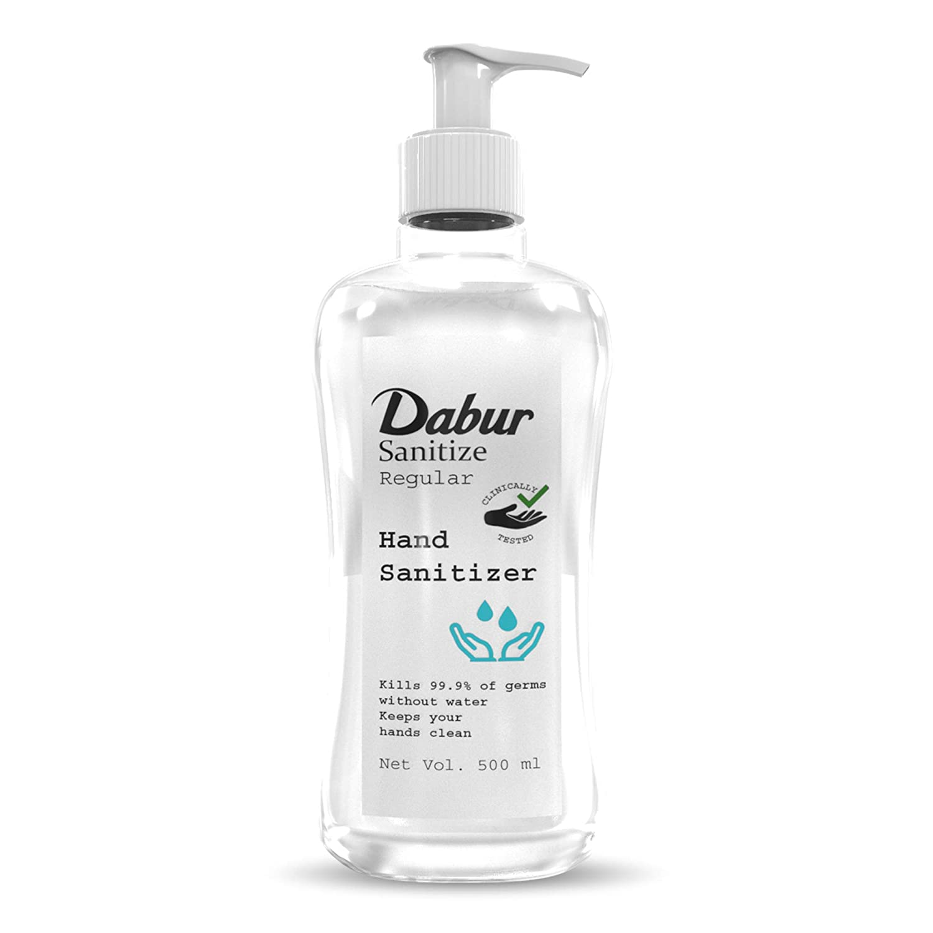
Pronunciation
Spelling
SANITIZER

Slide 5
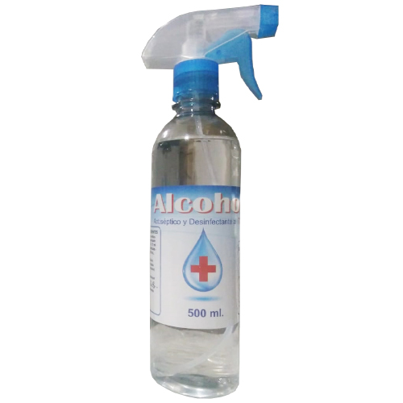
Pronunciation
Spelling
ALCOHOL

Slide 6
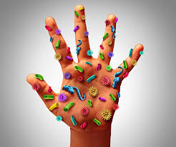
Pronunciation
Spelling
VIRUS

Slide 7
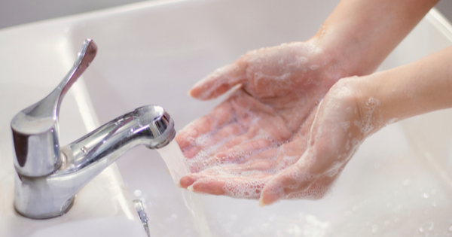
wash
hands
TO WASH THE HANDS

