Slide 1
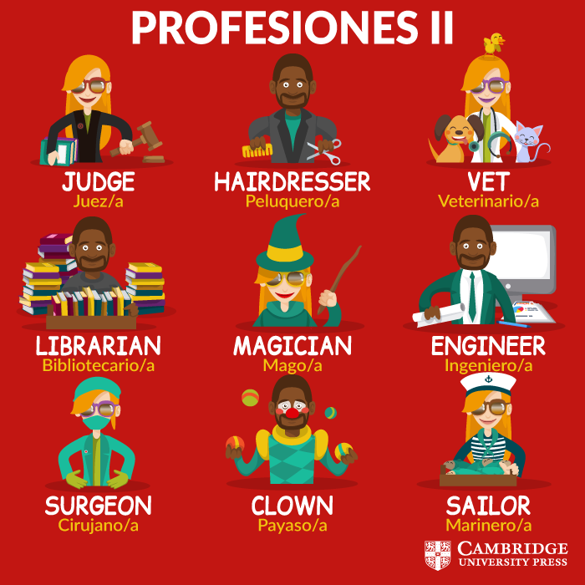
THE PROFESIONS

Slide 2

THE TEACHER

Slide 3

THE POLICEMAN

Slide 4

THE NURSE

