Slide 1

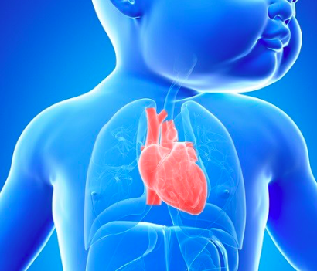
WORLD CONGENITAL HEART DISEASE DAY
PRESENTED BY:
MARIA FERNANDA PAREDES CRUZ
CYCLE: 6-2

Slide 2

WORLD CONGENITAL HEART DAY IS CELEBRATED EVERY FEBRUARY 14. IT IS A DATE CREATED WITH THE AIM OF HOLDING A WORLD DAY FOR THE EARLY PREVENTION OF THIS DISEASE, WHERE AFFECTED PATIENTS CAN RECEIVE PROPER TREATMENT AND THUS BE ABLE TO GUARANTEE A BETTER QUALITY OF LIFE.

Slide 3

WHAT ARE CONGENITAL HEART DISEASE?
CONGENITAL HEART DISEASE IS A CONDITION OR DISORDER, WHERE THE HEART UNDERGOES AN ABNORMAL DEVELOPMENT, WHICH NORMALLY OCCURS BEFORE BIRTH. MANY OF THE BABIES WHO SUFFER FROM IT DIE FROM THIS CAUSE. MANY CHILDREN ARE BORN WITH THIS CONDITION, SO IT IS NECESSARY TO SUBMIT THEM AT A VERY EARLY AGE TO SURGERY AND THEN TO TREATMENT, IN ORDER TO AVOID THEIR DEATH. HOWEVER, SOME MANAGE TO SURVIVE AND REACH ADULTHOOD WITHOUT PROBLEMS.

Slide 4
HOW TO CELEBRATE CONGENITAL HEART DISEASE DAY?
TO CELEBRATE CONGENITAL HEART DISEASE DAY ON FEBRUARY 14, MORE PARTICIPATION AND AWARENESS IS NEEDED BY THE POPULATION, SINCE IT IS A DISEASE THAT CAN APPEAR UNEXPECTEDLY, BUT THE IMPORTANT THING IS TO HAVE THE NECESSARY TOOLS AND KNOWLEDGE TO FACE IT. FOR THIS 2020, A TRIP TO THE CAMINO DE SANTIAGO HAS BEEN PROGRAMMED THROUGH THE MENUDOS CORAZONES FOUNDATION, WHERE 18 YOUNG PEOPLE WHO SUFFER FROM THIS DISORDER WILL MAKE A JOURNEY OF 89 KILOMETERS, AS A WAY TO ENCOURAGE OTHER PATIENTS AND SHOW THAT THERE ARE NO LIMITS BEFORE AN ILLNESS. MAYBE YOU KNOW SOMEONE WHO IS FACING A BATTLE AGAINST THIS DISEASE RIGHT NOW OR IS CLOSE TO YOU BECAUSE YOU HAVE A FAMILY MEMBER WITH THIS CONDITION. SO TODAY IS THE DAY TO RUN YOUR OWN CAMPAIGN AND HELP MAKE ALL THESE PEOPLE VISIBLE TO IMPROVE THEIR QUALITY OF LIFE.

Slide 5

THIS PRESENTATION IS IN HONOR OF MY DAUGHTER CELESTE MY LITTLE ANGEL

